Slide 1
Group Theory

Slide 2
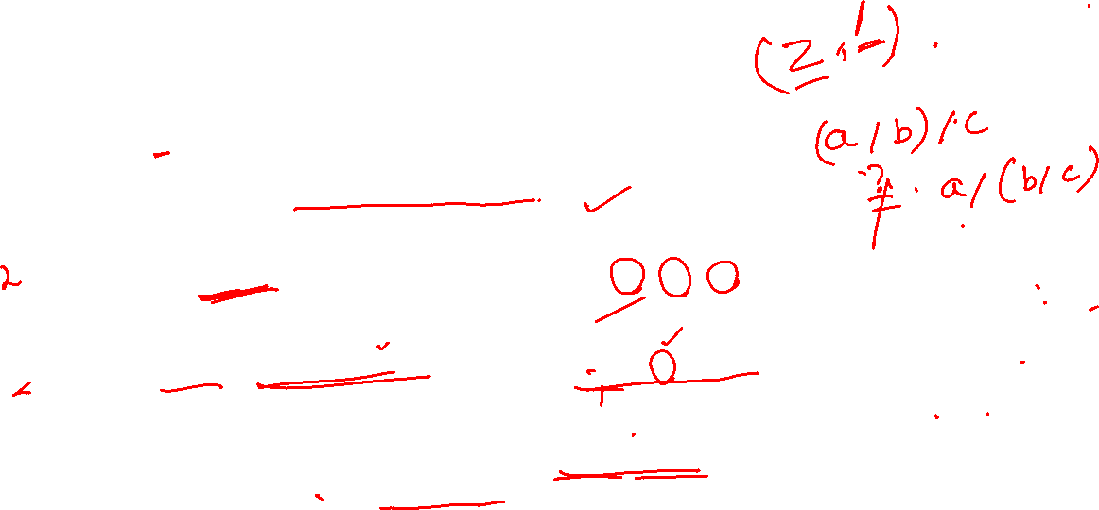
Definition
Let G be a nonempty set and let ∗ be a binary operation on G.
The pair (G, ∗) is called a group if the following are satisfied:
For all a, b, c ∈ G, (a ∗ b) ∗ c = a ∗ (b ∗ c).
(Associativity Property holds in G.)
There exists e ∈ G such that for each a ∈ G, a ∗ e = a = e ∗ a.
(Existence of Identity in G.)
3. For each a ∈ G, there exists b ∈ G such that a ∗ b = e = b ∗ a.
(Existence of Inverse in G. )
In addition, if the statement “For all a, b ∈ G a ∗ b = b ∗ a” is true, then the group (G, ∗) is called an an abelian (commutative) group.

Slide 3
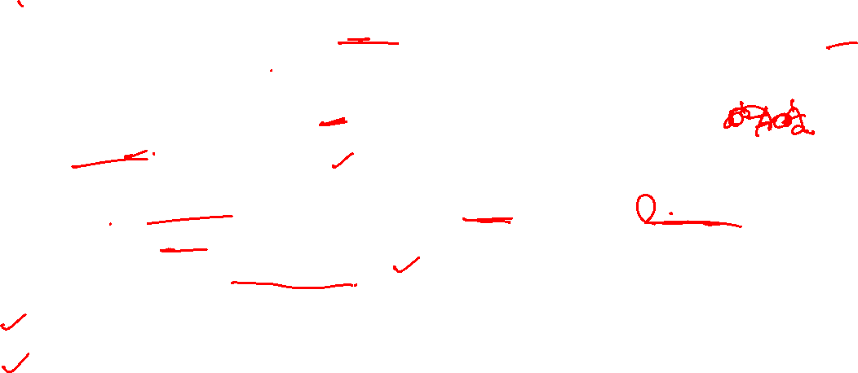
Remark
Let (G, ∗) be a group. Then the following hold:
The identity element of G is unique. Hence, keeping a definite notation such as e for the identity element is meaningful.
Corresponding to any a ∈ G, the element b ∈ G that satisfies a ∗ b = e = b ∗ a is unique. So, we denote such a b by a ⁻¹ , and call it the inverse of a.
e ⁻¹ = e.
For each a ∈ G, (a ⁻¹ ) ⁻¹ = a.
If a ∗ b = a ∗ c for some a, b, c ∈ G, then b = c. Similarly, if b ∗ d = c ∗ d for some b, c, d ∈ G, then b = c. That is, the cancellation laws hold in G.
For all a, b ∈ G, (ab) ⁻¹ = b ⁻¹a ⁻¹ .
By convention, we assume a ⁰ = e for each a ∈ G; and define a ^{n} = a ^{n−1} · a for n ∈ N. Then a ^{n} = a · a ^{n−1} .
For each a ∈ G, (a ^{n} ) ⁻¹ = (a ⁻¹ ) ^{n} for all n ∈ W. We write both (a ^{n} ) ⁻¹ and (a ⁻¹ ) ^{n} as
a ^{−n} .

Slide 4

Example [Symmetric Group on n letters/symbols]
Write N = {1, 2, . . . , n}. Recall that a bijection f : N → N is called a permutation on n elements. The set of all permutations on n elements is denoted by Sn, i.e.,
Sn = {f : N → N | f is one to one and onto}.
We observe the following:
Suppose f, g, h ∈ Sn. Then f, g, h : N → N are one-to-one and onto functions.
(a) Hence f ◦ g, the composition of f and g, is also one-to-one and onto. Thus, f ◦ g ∈ Sn. So, “composition of functions”, denoted ◦, defines a binary operation in Sn.
(b) It is well known that ◦ is an associative operation, i.e., (f ◦ g) ◦ h = f ◦ (g ◦ h).
(c) The identity function e : N → N defined by e(i) = i for all i = 1, 2, . . . , n is a one-to-one and onto function. Further, f ◦ e = f = e ◦ f for all f ∈ Sn. The permutation e is called the identity permutation.
(d) As f is a one-to-one and onto function, f ⁻¹ : N → N defined by f ⁻¹ (i) = j, whenever f(j) = i, for all i = 1, 2, . . . , n, is a one-one and onto function. So, for each f ∈ Sn, f ⁻¹ ∈ Sn and f ◦ f ⁻¹ = e = f ⁻¹ ◦ f.

Slide 5
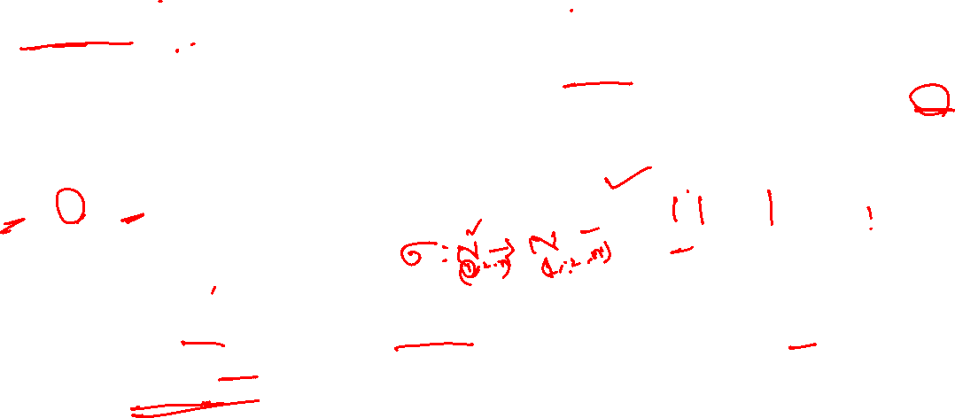
Cont.
2. Thus (S_{n}, ◦) is a group. This group is called the Symmetric group or the Permutation group on n letters/symbols.
3. [Product of permutations] Let σ, τ ∈ Sn. Then σ ◦ τ (the composition of σ and τ ) is popularly called the product of σ and τ . From now onwards, we will just use στ in place of σ ◦ τ , i.e, we will not use the symbol ◦ unless it becomes necessary for the sake of clarity.
4. If σ ∈ Sn then one represents this by writing
This representation of an element of Sn is called a two row notation.
5. Since σ : N → N is one-to-one and onto, {σ(1), σ(2), . . . , σ(n)} = N. Hence, there are n choices for σ(1), n − 1 choices for σ(2) (all elements of N except σ(1)) and so on. Thus, |Sn| = n!.

Slide 6
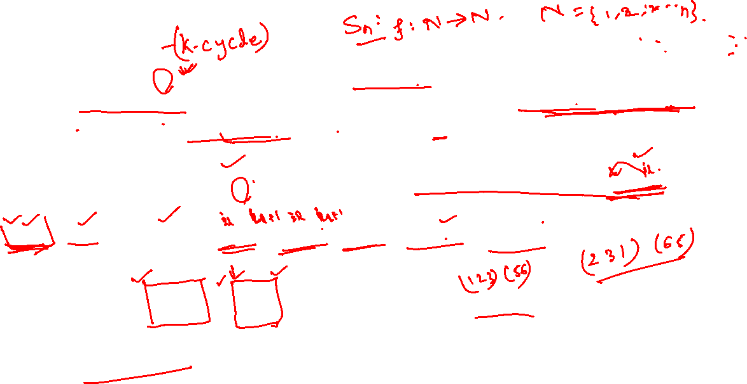
Definition
Let σ ∈ S_{n} and let S = {i₁, i₂, . . . , i_{k}} ⊆ {1, 2, . . . , n}. If σ satisfies σ(i_{l}) = i_{l+1} for each l= 1, 2, . . . , k − 1, σ(i_{k}) = i₁, and σ(r) = r for then σ is called a k-cycle and is denoted by σ = (i₁, i₂, . . . i_{k}) or (i₂, i₃, . . . , i_{k}, i₁) and so on
Example: The permutation in cycle notation can be written as (1234),
(2341), (3412), or (4123) as σ(1) = 2, σ(2) = 3, σ(3) = 4, σ(4) = 1 and σ(5) = 5.
2.

Slide 7
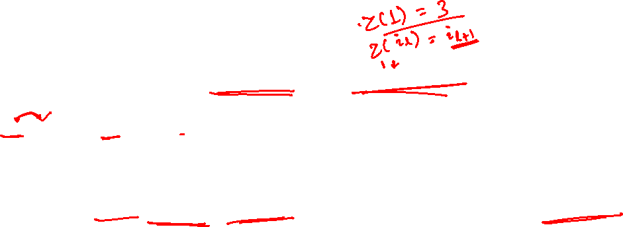
Cont.

Slide 8
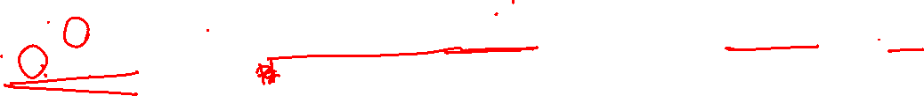
Definition (Subgroup)
Let (G, ∗) be a group. A nonempty subset H of G is said to be a subgroup of G, if (H, ∗) is a group.
Note: Let G be a group with identity element e. Then G and {e} are themselves groups and hence are subgroups of G. These two subgroups are called trivial subgroups.
Let G be a group and let a ∈ G, . The subgroup generated by a, denoted by

Slide 9
Two-Step Subgroup Test
Let H be a nonempty subset of a group G. Then H is a subgroup of G if and only if the following two conditions are satisfied

